Slide 1
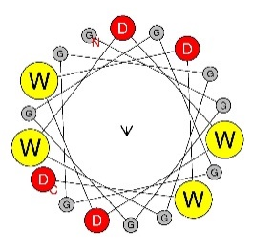
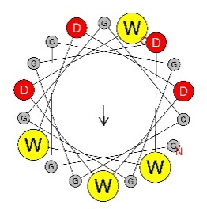
Fig. 1 Single W and single D is sufficient for functionality of AD.
A
B
C
Exp. setup
D
E
F
G
GGGGGGGGGGGGWDWDWDWD -1.13
GGGGGGGGGGGGDWWDDWDW 1.11
Figure 1. Single W and single D is sufficient for functionality of AD. A – experimental setup: oligo pool synthesis, cloning in bacteria, transformation in yeast, screening for growth phenotype, isolation of pool DNA, NGS sequencing, data analytics. B – X axis: individual sequences indicated in the inset table, where black dotes represent glycine, yellow dots represent tryptophan, and red dotes represent aspartic acid residues, Y axis: Log2 growth slope. C, D, E, F – same as B representing alternative sequences. E – sequence tables are simplified to show only 1 W & D and 5 W & D. Sequences with 2 W & D, 3 W & D, and 4 W & D fitting the same pattern of 0 to 9 glycines inserted between aromatic and acidic patches are represented in plot below. F – error bars accompany final sequence slopes. Error bars represent maximum and minimum growth slopes of the five bioreps associated with each sequence. G – indicated sequences with Log2 growth slope and images of the α-helix frontal view for corresponding sequence.

Slide 2
Fig. 2 Intermixing of acidic and aromatic residues is beneficial for function.
A
B
W = 6 D = 6
D
● - [DE]
● - [WYF]
●●●●
●●●●
●●●●
●●●●
●●●●
C
●●●●
●●●●
●●●●
WYF = 6 DE = 6
●●●●
●●●●
●●●●
●●●●
●●●●
●●●●
●●●●
●●●●
N → C
terminus
E
F
G
Functional tAD %
● - [DE]
● - [WYF]
Functional tAD %
ML Features | ROC AUC
aa | 0.61
aa x pos | 0.72
tetrapep | 0.78
tetrapep x pos | 0.82
Tetrapep x position + balance | 0.87
Tetrapep x position (Gcn4) – predict wd12 | 0.67
Shallow NNet | 0.90
●●●●
●●●●
●●●●
●●●●
●●●●
●●●●
●●●●
●●●●
●●●●
●●●●
●●●●
●●●●
●●●●
●●●●
●●●●
●●●●
N → C
terminus
Figure 2. Balance and intermixing of acidic and aromatic residues is beneficial for function. A – X axis: balance score calculated using formula N=nW-nD, Y axis: % of functional sequences in the pool of sequences containing all combinations of W and D for 12 positions (3968 sequences total). B – X axis: mixing score calculated using formula N =n(WD)+n(DW), Y axis: % of functional sequences in the pool of sequences containing all combinations of 6 W and 6 D (906 sequences total). C – X axis: mixing score calculated using formula N=n( [WYF][DE] ) + n( [DE][WYF] ), Y axis: % of functional sequences in the pool of sequences from Gcn4 random peptide library with 6 [WYF] and 6 [DE] (3018 sequences total). D – X axis: % of functional sequences in the pool of sequences that contain a certain tetrapeptide motif, Y axis: tetrapeptide motifs. E – X axis: Starting amino acid position of tetrapeptide in tAD module for the wd12 library, Y axis: 16 sequence combinations for tetra-peptides containing D and W, Tile fill: % of functional sequences in the pool of sequences that have a certain motif at a certain position. F – X axis: Starting amino acid position of tetrapeptide in tAD module for Gcn4 library, Y axis: 16 sequence combinations for tetra-peptides containing [DE] and [WYF], Tile fill: % of functional sequences in the pool of sequences that have a certain motif at a certain position. G – ML accuracy on hold out testing set measured with ROC AUC.

Slide 3
Fig. 3 Ds flanking W cluster is beneficial for AD functionality.
A
B
Gal4 (wd12) C-terminus
C
Gcn4 C-terminus
*
**
D
E
Sequence Constructs
. = G (Gly) x = W or D
● = D (Asp) ● = W (Trp)
***
*
........xxxxxxx●●●●●
***
..........●●●●●●●●●●
****
..........●●●●●●●●●●
. = Any amino acid ϕ = [AVILMWYF] ● = [WYF]
****
**
........................ϕϕϕ●●●
Figure 3. General end position of Ws or Ds flanking W cluster is beneficial for AD functionality. A – X axis: position of D (red line) or W (yellow line) within the sequence, Y axis: % of functional sequences in the pool of sequences containing all combinations of W and D for 12 positions (3968 sequences total). B – Y axis same as in A, X axis: size of W cluster preceding indicated end cap for sequences representing each line. C – same as B calculated for Gcn4 library using [WFY] instead of just W and [DE] instead of just D. D - sequences with indicated growth slopes. Red dots represent D and yellow dots represent W. E – sequence constructs of different starred sequences in previous figure 3 plots, to help visualize tAD sequences described in each plot. AlphaFold2 predicted structure displayed above sequence for ( ) and ( ) sequences.
***
****

Slide 4
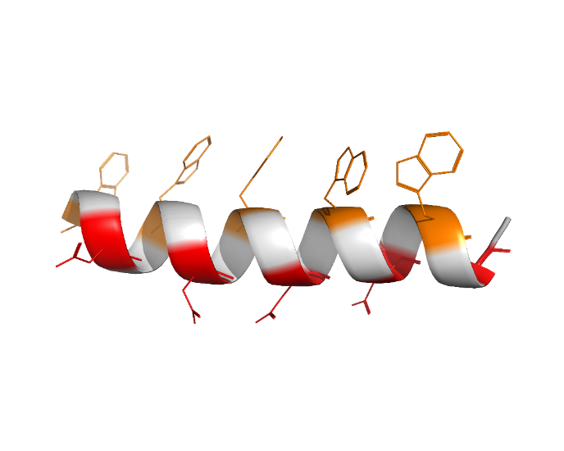
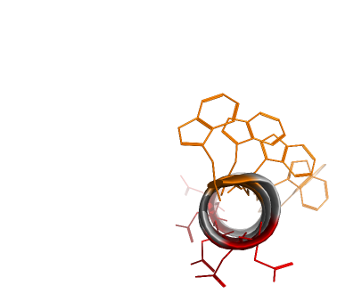
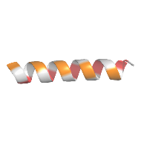
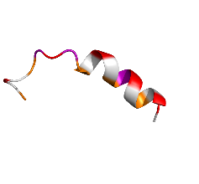
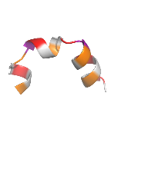
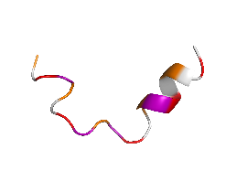
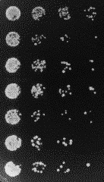
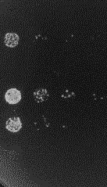
Fig. 4 Formation of the amphipathic α-helix is generally detrimental for AD functionality, while insertion of proline in it is beneficial.
WEDPWADPWPDGWPDLWADV 1.14 slope
WNDYWTDSWADYWYDFWYDV -4.26 slope
WFDSWDDFWCDCWCDCWSDF -4.12 slope
These are updated numbers to reflect in the paper: 107975 total sequences, (19.6% function)
A
Amphipathic Template
B
[W.D.W.D.W.D.W.D.W.D.]
Side view
Top view
C
D
0-P
3-P
2-P
*
4-P
E
No Aur
+Aur
Stop codon
GGGGDFDLDMLGDFDLDMLG
DDDDDDDDDDWWWWWWWWWW
DWDWDWDWDWDWDWDWDWDW
*
WEDPWADPWPDGWPDLWADV
WNDYWTDSWADYWYDFWYDV
WFDSWDDFWCDCWCDCWSDF
Figure 4. Formation of the amphipathic α-helix is generally detrimental for AD functionality, while insertion of proline in it is beneficial. A – graphical representation of sequences for the WD5 library, each member of which has five Ws, five Ds, and ten random amino acids between Ws and Ds represented by black dots/circles. B – Y axis: % of functional sequences in the WD5 library. X axis: % of α-helix predicted by SPOT-1D algorithm for each set of sequences from WD5 library. C – Y axis: % of functional sequences. X axis: count of corresponding amino acid residues between set Ws and Ds of WD5 library. D – 3D structures of sequences with varying number of proline residues. E – serial dilution assay testing tAD functionality. ( ) sequence is represented in both plot E and D.
*

